Slide 1


Slide 2
our mission
Notes:
Improving access to legal services through various improvements in the technologies lawyers use in their day-to-day operations.

Slide 3
what we do
Notes:
Modernizing an archaic and unorganized system that lawyers rely on. Putting the resources of big firms in the hands of solo and small firm lawyers, and in-house counsel for small and medium companies.

Slide 4
model legal document acquisition today
Notes:
Nearly all lawyers regularly prepare model legal documents. They use model legal documents as a starting point for most of the polished documents they draft. Unlike lawyers in large firms, lawyers in solo and small firms—as well as in-house counsel at small and medium companies—do not have the resources to maintain large databases of model documents. Instead, they turn to a variety of expensive, time-consuming, and unreliable sources of model legal documents. In this respect, solo and small firm lawyers and in-house counsel have a big unmet need.
Some lawyers pay a lot of money to access databases of legal documents on westlaw.com. A subscription to Westlaw’s legal form-finding service costs about $150 per month with a minimum 2-year contract. Some lawyers rely on printed books of forms which cost anywhere from $150 to $1,000 per volume and quickly go out-of-date. Lawyers also travel to the law library to find these books, and they even draft documents from scratch; both of these methods are time-consuming and create high costs that the lawyers have to justify to their clients. Occasionally lawyers will buy documents from websites that sell documents directly to lay consumers, such as nolo.com and uslegalforms.com, but sites like those are known for providing generic forms that are overpriced. Lawyers also frequently ask their colleagues for model documents; this technique works very well, as long as the colleagues actually have what the lawyers need. Solo and small practice lawyers are generally very willing to share their model legal documents with colleagues when asked. Email list serves for lawyer groups are abuzz across the nation with requests for model documents from solo and small firm lawyers. These circumstances create a perfect market opportunity for Vizibid.

Slide 5
we are the solution
Notes:
Vizibid is a website where lawyers (and only lawyers) can find, request, and share model legal documents for use in the practice of law. Vizibid also enables lawyers to rate documents in its database, share comments about the documents, and even share revised versions of the documents. By collecting the documents that lawyers share with each other and adding them to its searchable database, Vizibid will have the fastest-growing collection of the best lawyer-approved model legal documents in the world.

Slide 6
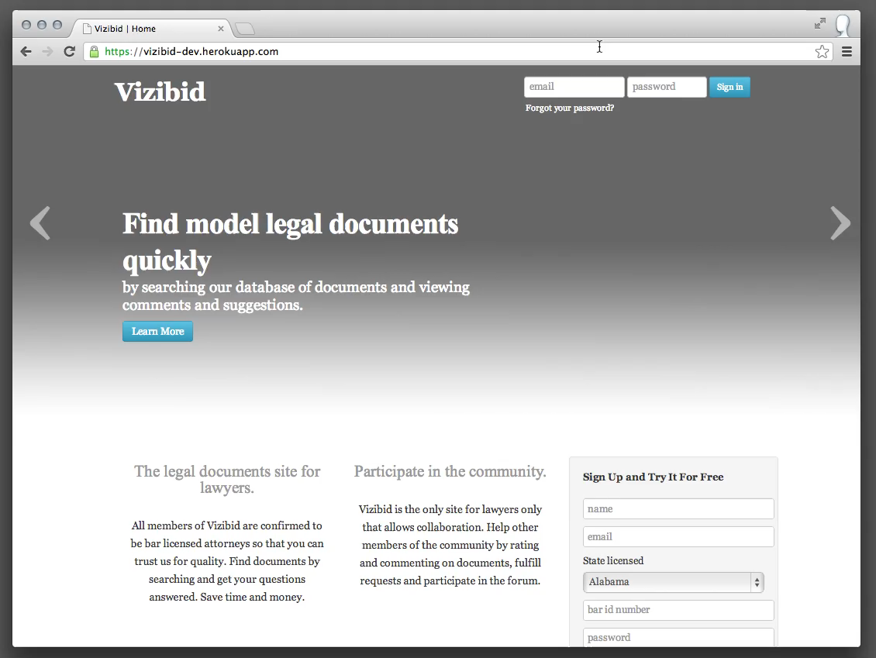
Notes:
[This slide is a screen cast. Click (or double-click) the image to watch the scenario unfold.]
Bob wants to find an LLC operating agreement for WA State. He searches the site and gets results. He then makes his search more specific and looks at the details page for the document. He likes what he sees so he downloads the document.

Slide 7
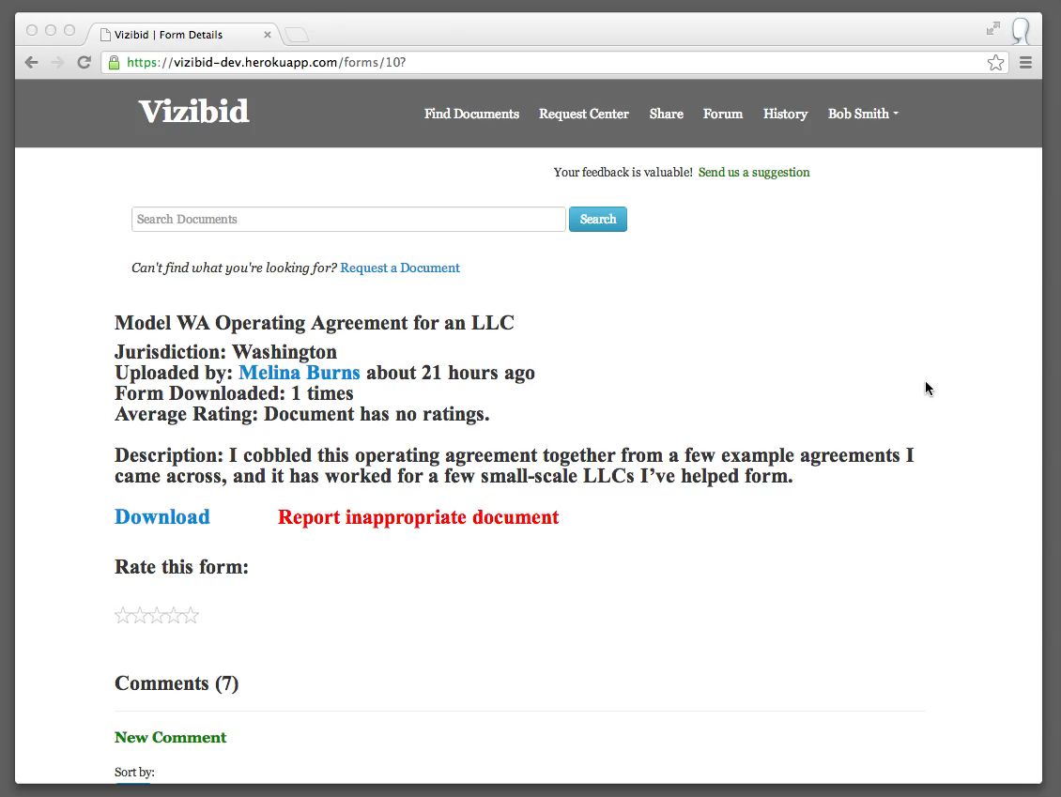
Notes:
[This slide is a screen cast. Click (or double-click) the image to watch the scenario unfold.]
Bob found the document useful. He signs-in to Vizibid and then up-votes an existing comment, adds a comment, and gives the form a rating.

Slide 8
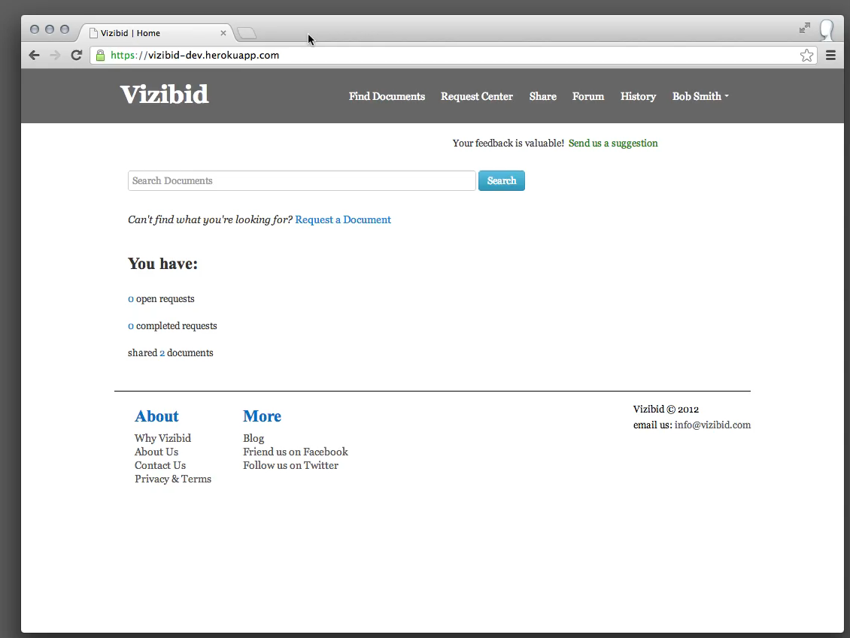
Notes:
[This slide is a screen cast. Click (or double-click) the image to watch the scenario unfold.]
Bob searches for a document. He doesn’t find what he’s looking for so he puts in a request for this document.

Slide 9
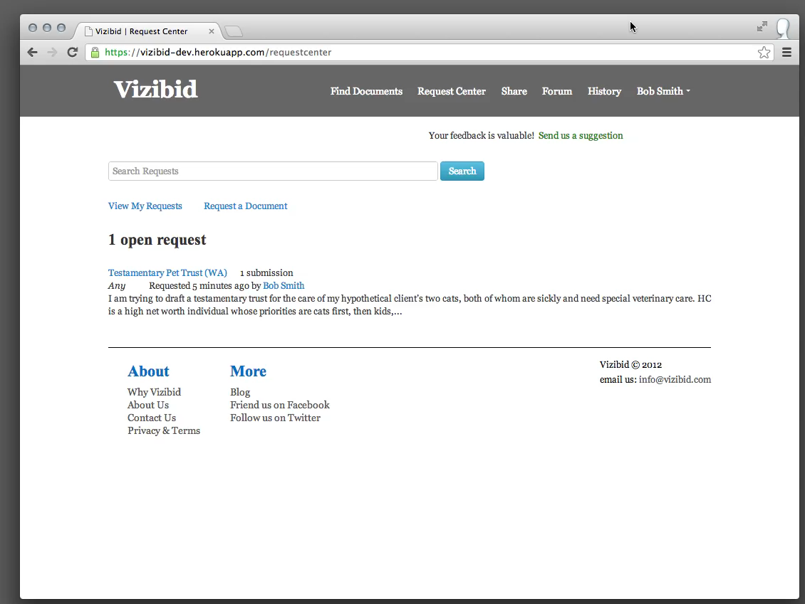
Notes:
[This slide is a screen cast. Click (or double-click) the image to watch the scenario unfold.]
Bob received email that his request got a response. He checks the response and marks his request as completed since he has gotten what he needed.

Slide 10
350,000 lawyers
Notes:
In the United States there are over 350,000 lawyers who practice alone or in small law firms. This is the total addressable market in the United States.
The American Bar Association (ABA) reports a total of 1,225,452 licensed attorneys in the United States as of April 2011. The percentage of all licensed attorneys in private practice was 73% in 1991 and 74% in 2000. Of those lawyers in private practice, 74% were in solo firms or firms with 20 lawyers or fewer in 1991, and 76% in 2000. Assuming the average of these percentages held true in April 2011, the ABA’s figures show that there were approximately 675,530 solo and small firm lawyers in the United States at that time. (See http://www.americanbar.org/content/dam/aba/migrated/marketresearch/PublicDocuments/lawyer_demographics_2011.authcheckdam.pdf)
The U.S. Bureau of Labor Statistics’ Occupational Outlook Handbook puts the total number of lawyer jobs in the U.S. at 728,200 in 2010. (See http://www.bls.gov/ooh/legal/lawyers.htm)
The National Association of Law Placement (NALP) reported in its August 2011 NALP Bulletin that 52.6% of male lawyers and 49.5% of female lawyers were in solo practice or firms with 25 lawyers or fewer in 2010. (See http://www.nalp.org/employmentpatterns1999-2010)

Slide 11
$25-50/month
Notes:
Vizibid’s users will pay a monthly subscription fee in the range of $25 to $50. With a subscription, users can search for, comment on, ask questions about, and request model legal documents. None of the other competing methods of acquiring model documents offers a comparable service.
Vizibid is able to offer its service at this highly competitive rate because of the low overhead associated with operating a web service when the content is primarily user-generated. The more users Vizibid has, the greater value Vizibid will provide to each user, and the more profit-per-user will be generated.

Slide 12
competition
Notes:
Vizibid competes with each of the previously mentioned methods (see slide 4) of obtaining model documents in some combination of better pricing, higher document quality, and less effort required from the user.

Slide 13
customer validation
Notes:
To validate the willingness of potential customers to become paying users of the Vizibid service, we have conducted (and continue to conduct) interviews with lawyers from various age groups and practice areas, and we are compiling their responses. One after another these potential customers have expressed giddy excitement about using the Vizibid service. Many of these lawyers have expressed their willingness to pay for the Vizibid service, stating that they would expect to pay anywhere from $20 to $100 or more per month. Each lawyer interviewed so far has also requested an invitation to join the service once Vizibid launches. As the momentum picks up, the need for fundraising to harness the momentum is growing.

Slide 14
customer acquisition
Notes:
We intend to market Vizibid’s services through ad placement in a variety of existing channels. These include search engine marketing and placing ads in regularly disseminated print and web publications directed to lawyers, such as the very common monthly magazines printed by bar associations and hundreds of other lawyer organizations. We will also foster relationships with individuals who have already voluntarily adopted roles in educating lawyers on the various software tools available to improve the practice of law in solo law offices and small firms. These individuals include bar association employees, law professors, and leaders of legal organizations. We will also offer incentives to existing users for referring new users to Vizibid. We intend to offer new users a free 30-day subscription to encourage user acquisitions and conversions.

Slide 15
soft launch
Notes:
Our go to market strategy involves a soft launch to a targeted set of early adopters. We will use this soft launch to validate the acceptable price point for the service and to validate the best incentive model which encourages users to actively participate in the Vizibid community. We will also use the soft launch to get broad feedback about the site in order to help us deliver the best possible experience when we launch broadly.

Slide 16
scale
Notes:
The more users Vizibid has, the greater value Vizibid will provide to each user, and the more profit-per-user will be generated.
We have developed a five-year projection that assumes an initial funding of $500,000 with a follow-on round of $500,000 after one year, a $25 per month subscription cost, and that we are able to capture approximately 10% of the addressable market within three years, then increase to 20% of the addressable market in the following two years.
Based on this model, we expect pre-tax profits of $2.9 million at the end of year 3, $10.9 million by the end of year 4 and $15.6 million by the end of year 5.

Slide 17
large firms
Notes:
We also expect demand from lawyers in larger law firms once the product becomes established with solo and small firms in the U.S. market. Attorneys in larger firms will find that Vizibid has a larger and more up-to-date collection of forms than what is currently available at their practice internally. We will also be able to privately host a firm’s collection of model legal documents which will provide Vizibid’s commenting, ratings, and search features around the firm’s private documents.

Slide 18
international and other professions
Notes:
We expect to be able to expand the product internationally after becoming established in the U.S. market. We are considering also expanding this service into other professions beyond lawyers if we discover there is a need.

Slide 19
$530,000
Notes:
We are raising $500,000. The capital will be used to finish the development of the site and do the soft launch.
We will require a second round of at least $500,000 after one year to support the company as it gets the user base to scale. This includes building out the team and on-going development and marketing costs.

Slide 20
founders: Forrest Carlson and Marc Beitchman
Notes:
Vizibid was cofounded by Marc Beitchman and Forrest Carlson. Marc Beitchman is a professional software engineer at Microsoft with diverse development experience ranging from low-level computer architecture and compilers to application platforms and web services. At Vizibid, Marc is in charge of product and business strategy development. Marc will finish his master’s degree in computer science and engineering from the University of Washington in June of this year. He received his bachelor’s degree in computer science and music engineering from the University of Miami.
Forrest Carlson is a lawyer with a solo law practice in Seattle, Washington. As a practicing lawyer, he is intimately aware of lawyers’ day-to-day operational needs. Forrest is excited about the many emerging possibilities in the realm of service technologies for lawyers. Vizibid is part of Forrest’s vision for improvements to the legal profession through a more complete expression of the collective intelligence, training, and good will of lawyers. At Vizibid, Forrest drives the development of the customer experience, product design, and company vision. Forrest received his JD from Seattle University School of Law and his bachelor’s degree from Seattle University.

Slide 21
questions

